Slide 1
Interacting with Databases
Overview
In this lesson, students will learn how to interact with a database in Python.
Duration 120 minutes
Learning Objectives
In this lesson, students will:
Create a database using DB Browser for SQLite
Use select, insert and update, both by hand and in code.
Write code to the DB-API 2.0 specification

Slide 2
Pre-Class Materials and Preparation
For remote classrooms: Virtual breakout rooms and Slack may be needed to facilitate the partner exercise and discussions. As you plan for your lesson:
Consider how you’ll create pairs for the partner exercise (randomly, or with pre-assigned partners).
Determine how (if at all) exercise timing may need to be adjusted.
For helpful tips, keep an eye out for the For remote classrooms tag in the speaker notes.
Prepare screenshots and answers to exercises in advance so that they can be easily shared in Slack during your lecture.

Slide 3
Suggested Agenda
Time | Activity
0:00–0:20 | Welcome + Introduction
0:20–0:30 | Install DB Browser for SQLite
0:40–0:50 | Create Tables
1:10–1:20 | Add some data to your database
1:30–1:50 | Birthday Reminder App
1:50–2:00 | Wrapping Up, Q&A, and Exit Ticket Completion

Slide 4
Environment
The lesson was written with the expectation that students would be creating programs in a text editor, but it should also work successfully if students are learning in a Jupyter notebook.
This lesson also requires students to download and install DbBrowser for SQLite, which may be difficult in enterprise contexts. Students will be introduced to the basics of SQL.

Slide 5
Interacting with Databases

Slide 6
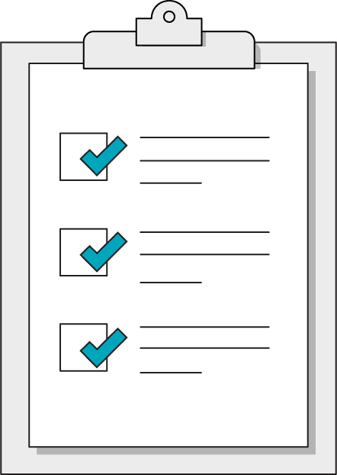
Today’s Learning Objectives
In this lesson, you will:
Create a database and tables.
Query a database from an application and from Python code
Write a program that inserts and updates data in a database
‹#› | © 2020 General Assembly
Notes:
Purpose: Set expectations for the lesson.
For remote classrooms:
Capture a screenshot of this slide and drop it in the class Slack channel.

Slide 7
Introduction
Interacting with Databases
Notes:
Duration: 30 minutes

Slide 8

We have learned how to operate with files
But very few programs operate exclusively on files.
Data analysts and data scientists often fetch data from databases
Software developers almost always write programs that work with databases
In today’s lesson we will write a reminder program that keeps its data in a database.
‹#› | © 2020 General Assembly
Notes:
Purpose: Set expectations for the lesson.
For remote classrooms:
Capture a screenshot of this slide and drop it in the class Slack channel.

Slide 9




Benefits of a Database
Sharing
The Whole Picture
Structure
Decision Making
Increase access to data for the whole organisation and beyond.
Easy to see how processes in one department of the company affect other departments.
Allows to categorise and structure available data.
Provides information for making better, faster decision in a company.
Notes:
Purpose: Discuss benefits of a database.
TALKING POINTS
Databases give broader access for sharing, a bigger picture of how processes work between different parts of a business, allow valuable structure for data and provide fast information for better decision making.

Slide 10







Where do I start?
Notes:
Purpose: Discuss all the different database systems.
TALKING POINTS
There are many different DBMS or database management systems, with pros and cons for each.
Picking: https://datahq.co.uk/knowledge-hub/blog/top-10-considerations-when-choosing-a-database-management-system

Slide 11

What Is SQL?
SQL is short for Structured Query Language.
It’s a language you can use to query information from your database, where all of your data lives. You can use it to ask questions and make requests such as:
“How many users logged in this week?”
“Show me the posts by this user from the past month.”
Notes:
[Pre-work recap] Purpose: Introduce SQL as a language.
TALKING POINTS:
SQL was developed at IBM by Donald D. Chamberlin, Raymond Boyce, and Edgar Codd in the 1970s.
There are a number of different proprietary implementations of SQL databases and platforms, most of which support standard (ANSI) SQL, including:
PostgreSQL
MySQL
MS SQL
Oracle
Almost anything that persists on the internet after you close your browser is using a SQL database; for example, login information, user profiles, etc.
Examples: The application would ask these questions (I write the application logic):
“How many users logged in this week?”
“Show me the posts for user123.”
TEACHING TIPS:
Students covered these points in the pre-work. You can skip this slide or, if you prefer, quickly recap it during class.
If you cover this slide, ask students to share what they learned about SQL in the pre-work to complement what’s on this slide.

Slide 12

Benefits of SQL
Industry standard.
Available in free and open versions.
Query, retrieve, and aggregate millions of records.
Cloud-based data query and retrieval; not limited to your local computer system.
Allows users to remotely interact with large data sets in production.
Broad community support.
Notes:
[Pre-work recap] Purpose: Frame up why SQL is a useful tool.
TALKING POINTS:
In our discussion, we covered why SQL is a step up from managing data in spreadsheets or documents.
TEACHING TIPS:
Ask: Based on what you know about SQL, what other benefits are there?
Simplified data access.
Industry standard for relational tables.
High-level command structure.
Approachable syntax and code requirements.
Available in free and open-source versions.

Slide 13
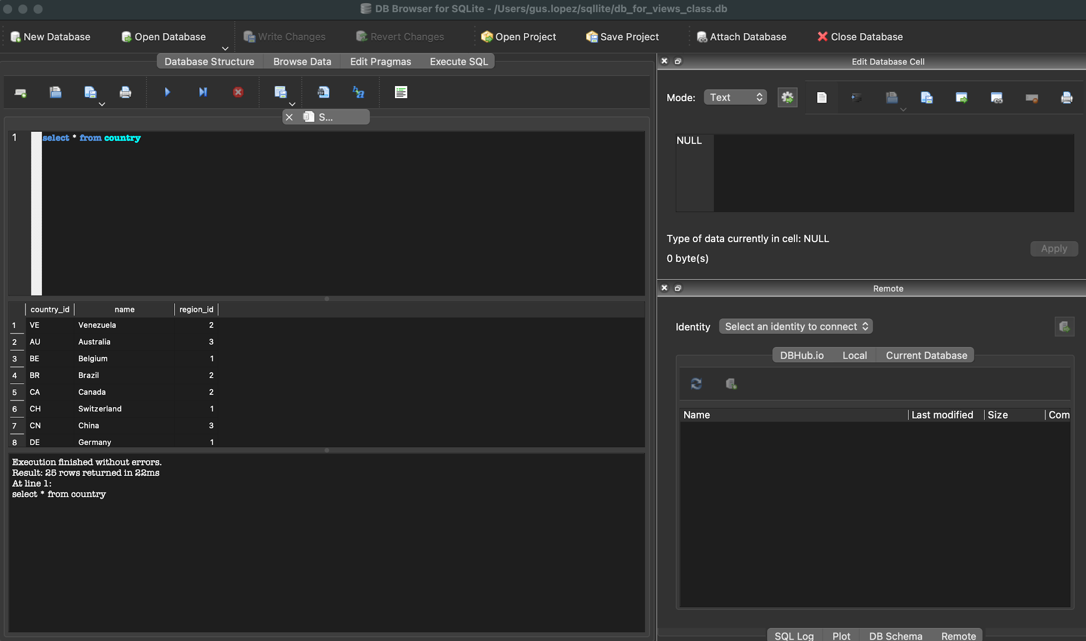
Install DB Browser for SQLite
10 mins
We are going to use DB Browser for SQLite.
Please install using this link: https://sqlitebrowser.org/dl
SQLite is free
It is extremely reliable (very few bugs)
Part of the Python distribution
One of the most popular databases
Notes:
Purpose: Explain to students that we are using SQLite.
TALKING POINTS
We are using SQLite and DB Browser for SQLite
Everything we do in this lesson is very similar on other database platforms
https://wiki.PostgreSQL.org/wiki/PostgreSQL_Clients

Slide 14
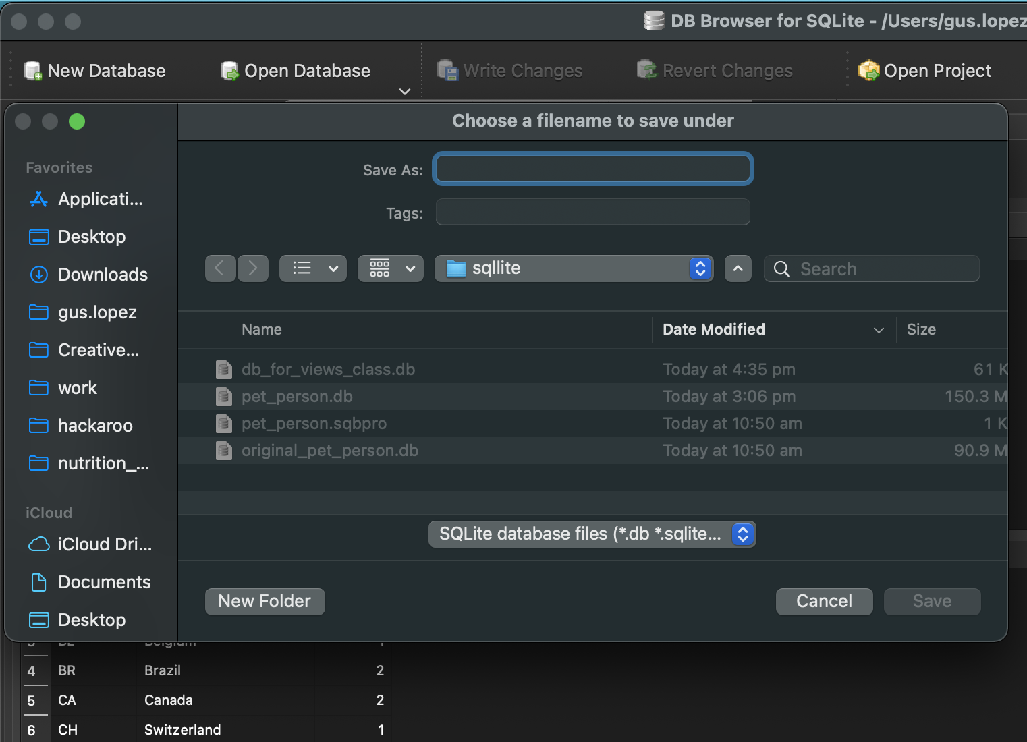
Database Creation
Create a new DB by clicking the “New Database” button at the top. Provide the name and the location of where the DB will be in your computer.
Notes:
Purpose: Explain difference between a database and a table.
TALKING POINTS
A database is an organised collection of data in the form of tables, indexes, etc.
A table organises the information about a single topic into rows and columns.
For example, a database for business would typically contain a table for customer information, a table for products, etc.
https://www.quora.com/What-is-the-difference-between-database-and-table

Slide 15

Now what?
Awesome, I’ve created a database.
Where is everything?
Where do I store the data?
Source: https://giphy.com/gifs/memecandy-gIfgb4RSmErc07m4n9
Notes:
Purpose: Introduce tables within database.
TALKING POINTS
Now we’ve created a named database, where is all the data? We have to put it in!
But where do we put the data? The answer is tables!

Slide 16
Database vs Tables
A database is an organised collection of data in the form of tables, indexes, etc.
A table organises the information about a single topic into rows and columns.
For example, a database for business would typically contain a table for customer information, a table for products, etc.
Notes:
Purpose: Explain difference between a database and a table.
TALKING POINTS
A database is an organised collection of data in the form of tables, indexes, etc.
A table organises the information about a single topic into rows and columns.
For example, a database for business would typically contain a table for customer information, a table for products, etc.
https://www.quora.com/What-is-the-difference-between-database-and-table

Slide 17
Common SQL Data Types
 | Explanation
character | Limited-length text-based string
text | Unlimited amount of text
numeric | Floating-point number
integer | Whole number
timestamp | Date and time
date | Just the date
Notes:
TEACHING TIPS:
Speak to the decision-making of a DB admin in assigning data types.
E.g., Why do some columns have numbers and yet are assigned a text data type?

Slide 18
Create Table
CREATE TABLE creates a new, initially empty table in the current database. We must define what columns each row should have, along with their data type. This example shows off all the sort of things that can be done with SQL commands:
CREATE TABLE films (
code char(5) CONSTRAINT firstkey PRIMARY KEY,
title varchar(40) NOT NULL,
did integer NOT NULL CHECK did > 0,
date_prod date,
kind varchar(10) REFERENCES kinds(kind_id));
Fortunately, we don’t need to do all that! We’ll just use DB Browser to build tables.
Notes:
Purpose: CREATE TABLE creates a new, initially empty table in the current database.
TALKING POINTS
To create a table within the database, use the CREATE TABLE command.
You give the table a name, e.g. films.
Then within the parentheses, each column should be defined with the name of the column followed by the data type.
The table will be owned by the user issuing the command.
https://chartio.com/resources/tutorials/how-to-list-databases-and-tables-in-PostgreSQL-using-psql/

Slide 19
Create a Table
10 minutes
In your newly created database, create the following two tables with the following columns. :
Table #1: Birthdays
Person
Date_Of_Birth
Table #2: Anniversaries
Name
Partner_Name
Day_of_Anniversary
HINT: Do not worry about NULLs or PRIMARY KEYS for the time being.
Just make everything a TEXT field. We can change it later.
Notes:
Purpose: Get students to create tables.
TALKING POINTS
You can also try to use the CREATE TABLE syntax to create two tables. Do not worry about NULLs or PRIMARY KEYS.

Slide 20
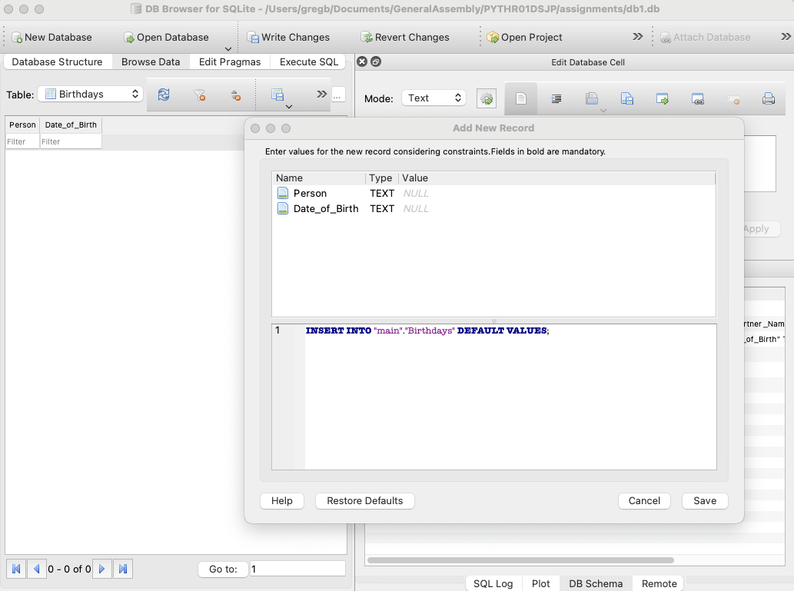
Insert some data into your database
Browse Data
Select a table
Long click on the “new record” button
Insert Values
As you enter data, you will see an INSERT statement being created.
Notes:
Purpose: Use the GUI to insert some data initially.
TALKING POINTS:

Slide 21
The SQL Behind The Scenes
This is how you inserted data into a database.
As you enter data, you will see an INSERT statement being created.
INSERT INTO Birthdays (Person, Date_of_Birth) VALUES ('Greg', '18-December');
Table name
Column names
Notes:
Purpose: Gently introducing students to the idea of SQL as a language
TALKING POINTS:

Slide 22
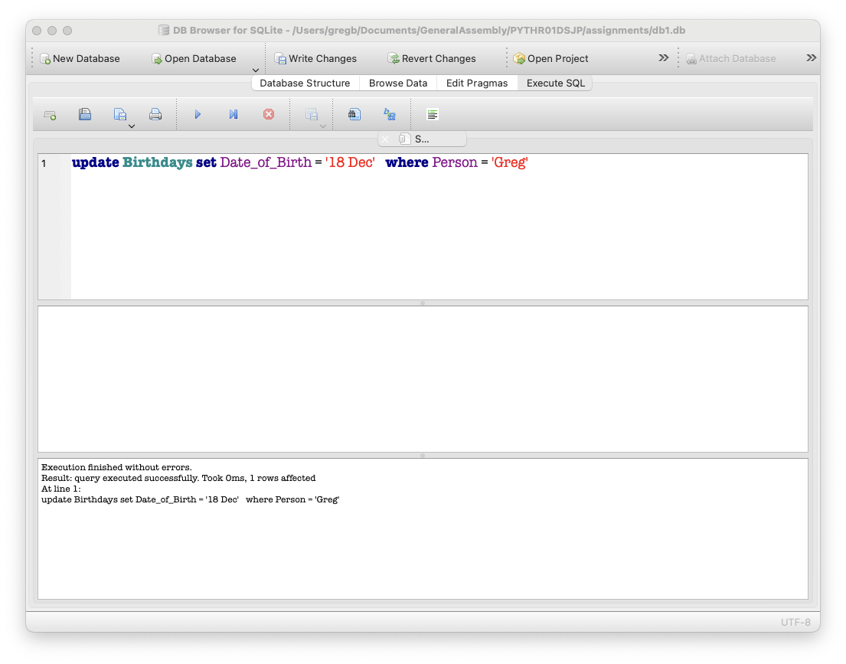
Updating your database
Click on Execute SQL
Type in this command. Line breaks don’t matter.
update Birthdays set Date_of_Birth = '18 Dec' where Person = 'Greg'
This will update every row where ‘Greg’ is in the person column.
Notes:
Purpose: Get used to entering SQL statements
TALKING POINTS:

Slide 23
All good?
Write your changes.
(“Commit your changes”)
Until you do, they aren’t saved, and other programs can’t see these new values.
Notes:
Purpose: Understand the concept of committing a transaction
TALKING POINTS:

Slide 24

The SQL Query Order of Construction
SELECT picks the columns.
FROM points to the table.
WHERE puts filters on rows.
GROUP BY aggregates across values of a variable.
HAVING filters aggregated values after they have been grouped.
ORDER BY sorts the results.
LIMIT limits results to the first n rows.
The Query Building
Notes:
Purpose: Review the SELECT, FROM, and LIMIT statements in the context of SQL queries.
TEACHING TIPS:
You’re setting the stage here; quickly describe the goal of each phrase.
Recommend that they use the major command structure down the left edge for readability and ease of debugging.
Not all commands must be included, but when used, this is their required sequence. (For beginners, keep it simple; resist the temptation to describe all the nested possibilities.)
TALKING POINTS:
You can think of a SQL query as a well-functioning building with various parts that all contribute to its operation.
SQL is used to communicate questions to the database. The two main clauses are SELECT, FROM.
Each line listed is a clause, and each boldfaced command has a specific job to accomplish.

Slide 25
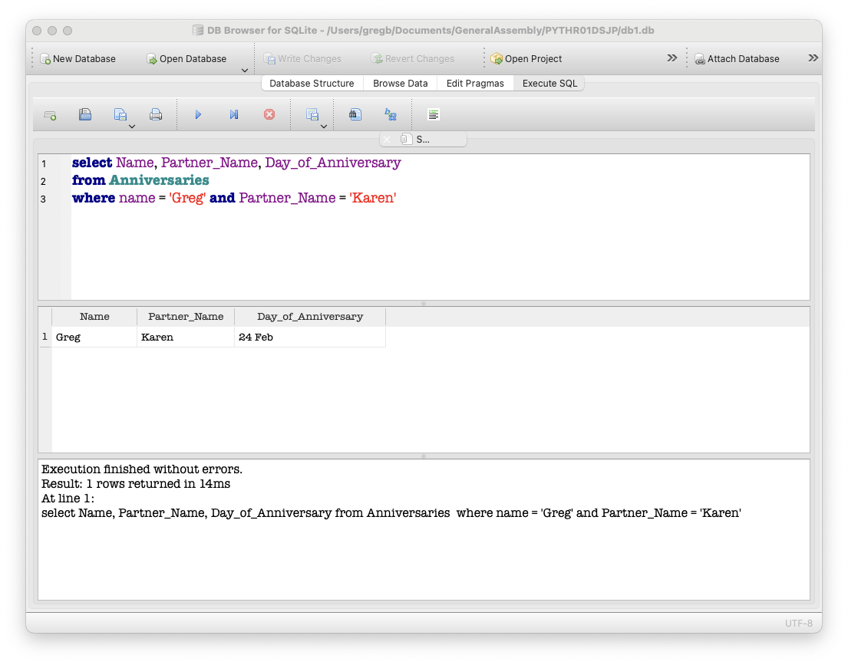
Reading From a Database
SELECT Name, Partner_Name,
Day_of_Anniversary
FROM Anniversaries
WHERE Name = 'Greg'
and Partner = 'Karen'
Notes:
Purpose: Learn a basic SELECT statement

Slide 26
Add some data to your database
10 minutes
Make sure your database has some dates of birth and some anniversaries in it.
Make sure you know how to use an INSERT and an UPDATE. Don’t forget to commit changes.
Query some rows using SELECT to make sure the rows are there.
Notes:
Purpose: Have some data ready for the next section
TEACHING TIPS:

Slide 27
DB-API
Interacting with Database
Notes:
Duration: 30 minutes

Slide 28
The standard five of the DB-ABI
import sqlite3
connection = sqlite3.connect('db1.db')
cursor = connection.cursor()
cursor.execute("""SELECT Person, Date_Of_Birth FROM Birthdays WHERE PERSON = ?""",
['Greg'])
for row in cursor:
name = row[0]
date_of_birth = row[1]
print(f"{name} was born on {date_of_birth}")
Import library
Make a connection
Make any cursors
Execute a query
Iterate over the results. (Optional)
Notes:
Purpose: The standard way of writing a query
TEACHING TIPS:

Slide 29
What does an insert look like?
import sqlite3
connection = sqlite3.connect('db1.db')
cursor = connection.cursor()
name = input("Whose birthday do you want to add? ")
birthday = input("When is their birthday? ")
cursor.execute("INSERT INTO Birthdays (Person, Date_Of_Birth) VALUES (?,?)",
[name, birthday])
connection.commit()
Notes:
Purpose: See some code with an insert statement, and the use of commit on the connection
TEACHING TIPS:

Slide 30
What does an update look like?
import sqlite3
connection = sqlite3.connect('db1.db')
cursor = connection.cursor()
name = input("Whose birthday do you want to modify? ")
birthday = input("When is their birthday? ")
cursor.execute("UPDATE Birthdays SET Date_Of_Birth = ? WHERE Person = ?",
[birthday, name])
connection.commit()
Notes:
Purpose: See some code with an update statement in it
TEACHING TIPS:
Introduce the “Don't repeat yourself” mantra.
This pattern will take all day, require constant updating if the list changes, and clog our program with endless copies of the same line.
Not to mention, there’s an increased chance for typos!

Slide 31

Why we used those ? markers - SQL injection attacks
‹#› | © 2020 General Assembly
Notes:
Purpose: Explain what an SQL injection attack is, and why we use placeholders
TEACHING TIPS: This slide deck might be helpful if you want to provide some more detail https://docs.google.com/presentation/d/1C1ySqVJ2_uofLtMMUXahEZoR4aKkC308LcwXhFgfxhg
You might want to write a small program that has an SQL injection vulnerability to cause a problem.

Slide 32
Birthday Reminder
15 minutes
Use the SELECT example on slide 25 as a starter. Write a program that does the following:
Asks the user to enter a date
Runs a query against the database that returns the names of people whose birthday is that date.
Prints out the names
Bonus: update your program to show you any anniversaries as well
Notes:
Purpose: Have some data ready for the next section
TEACHING TIPS:

Slide 33
And one last thing … what does an delete look like?
import sqlite3
connection = sqlite3.connect('db1.db')
cursor = connection.cursor()
name = input("Whose birthday do you want to delete? ")
cursor.execute("DELETE FROM Birthdays WHERE Person = ?",
[name])
connection.commit()
Notes:
Purpose: See some code with an delete statement.
TEACHING TIPS:

Slide 34
Wrapping Up
Interacting with SQL Databases
Notes:
Duration: 10 minutes

Slide 35
Recap
Looking Ahead
In today’s class, we…
Created a database.
Created tables in a database
Queried and updated rows in a database
On your own:
Think up some other database-driven programs that would be useful to you.
Read up about more SQL commands:
DELETE FROM … WHERE …
CREATE INDEX
SELECT …. ORDER BY
Notes:
Purpose: Recap what was covered in the lesson.

Slide 36

Don’t Forget: Exit Tickets!

